Slide 1



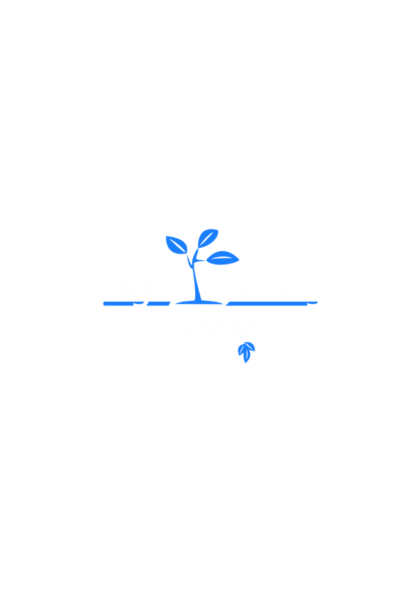

HackOrbit 2025
AgroVibe

Slide 2

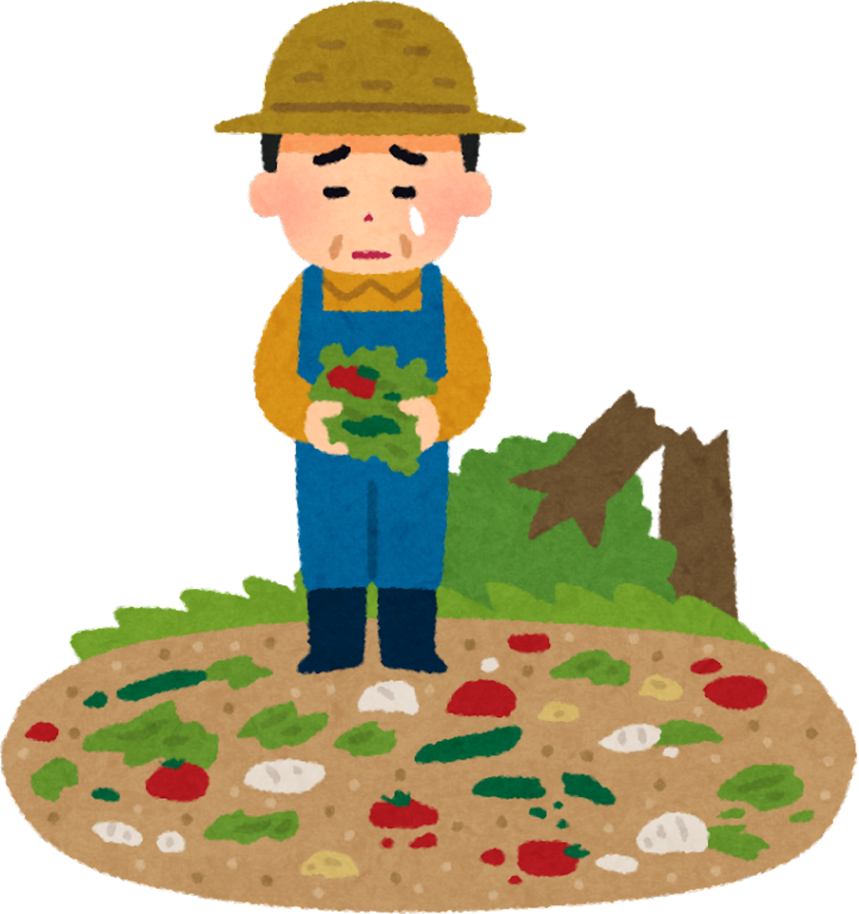
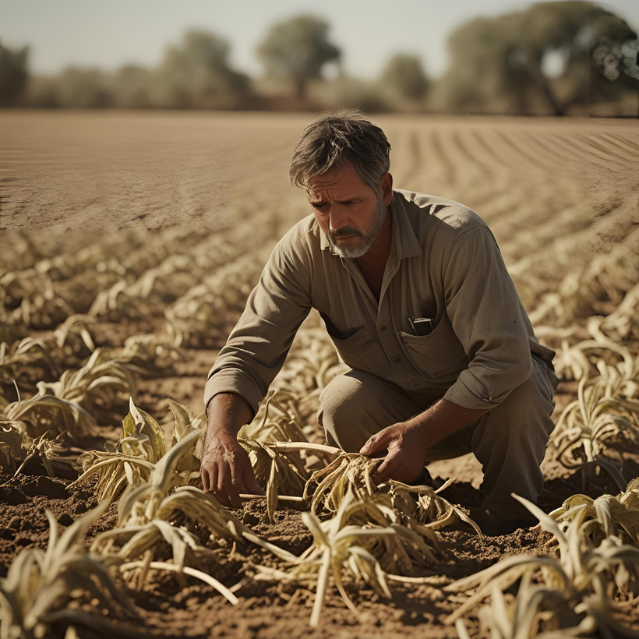
THEME & PROBLEM STATEMENT
Our Theme is Sustainability
Hard to monitor crops all the time.
Manual checking takes time and effort.
Power cuts stop farm devices from working.
No simple, low-cost smart farm tools for small farmers.
Farmers need help to control water and devices easily.

Slide 3


PROPOSED SOLUTION
A smart system to check farm conditions automatically.
Sensors measure soil, water, and weather.
Farmers see live data on a mobile app.
App lets farmers control pumps and sprinklers remotely.
Solar backup keeps system working during power cuts.
Simple and affordable for all farmers.

Slide 4


IDEA
EcoFarmX is a smart farming solution that helps farmers monitor and control their fields using technology. It makes farming easier, saves resources, and ensures a better harvest for tomorrow.
our project logo

Slide 5
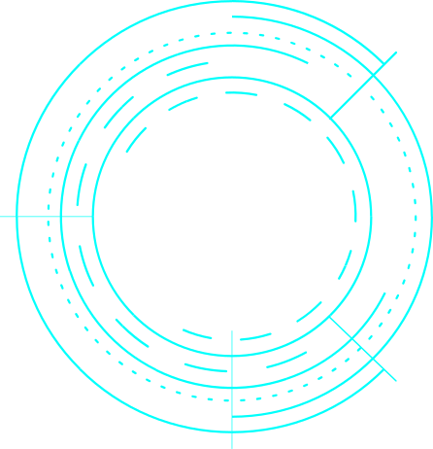
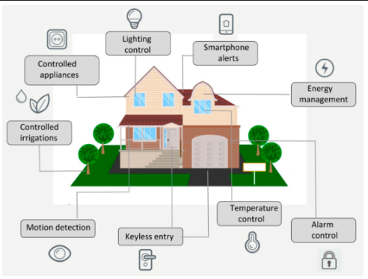

TECHNOLOGY USED
IoT sensors
Mobile app
Solar power
Cloud data
Alerts system
Automation
sample picture

Slide 6
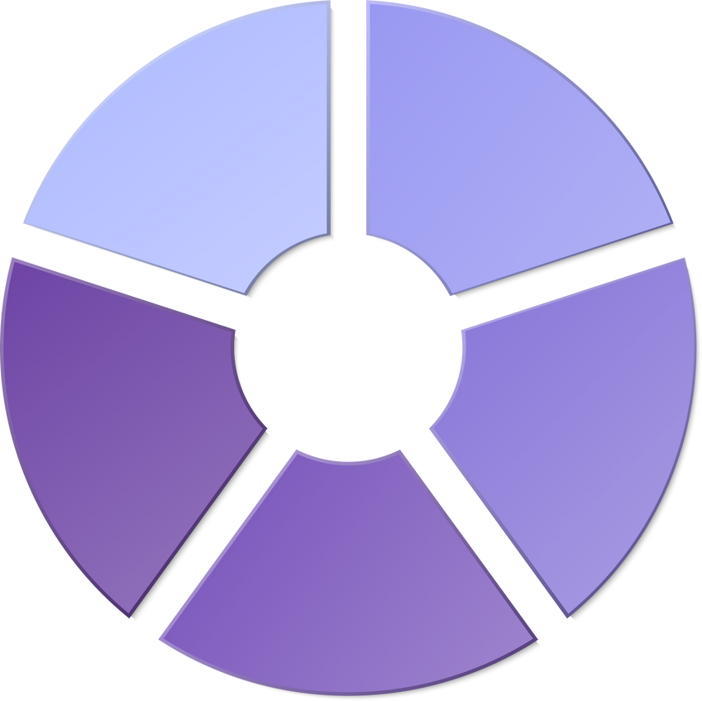

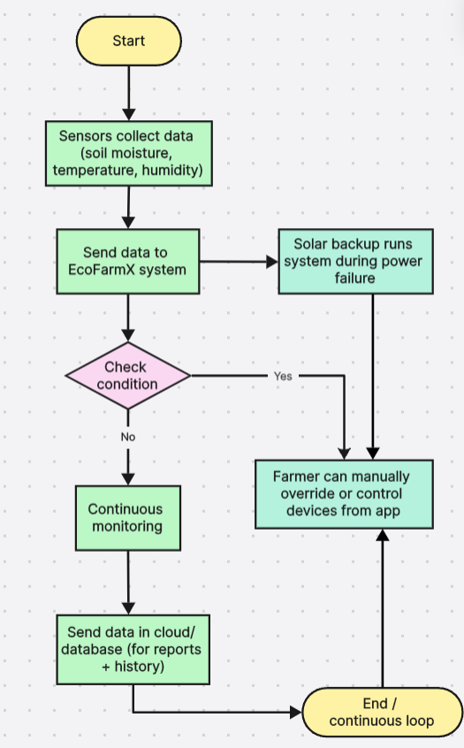


FLOWCHART / DIAGRAM

Slide 7
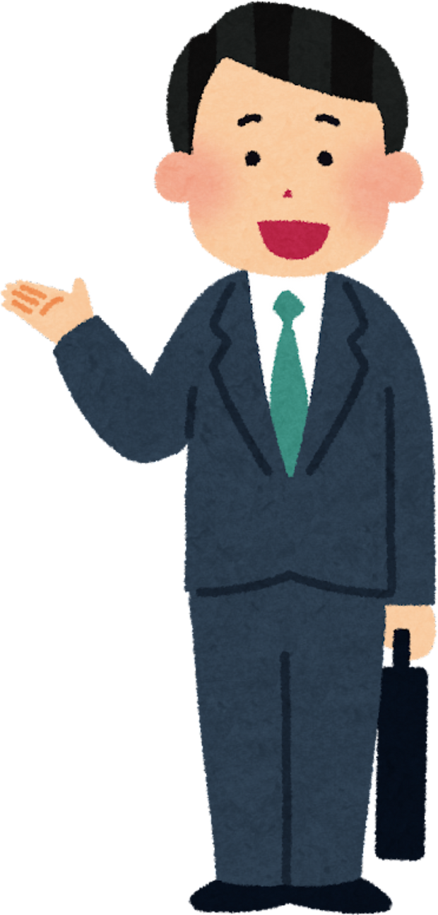
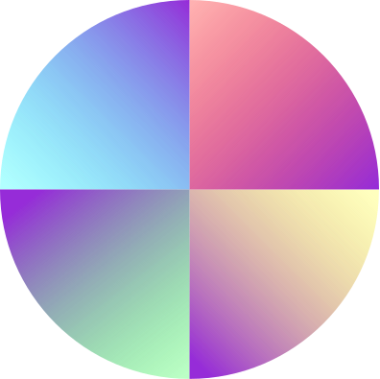
FLOWCHART / DIAGRAM
Start the system
Sensors collect data (soil moisture, temperature, humidity)
Send data to EcoFarmX system
System checks conditions
If action needed → turn on pump/fan automatically
If no action → keep monitoring
Solar backup keeps system running during power cuts
Data saved in cloud for reports and history
Farmer can control devices using the app anytime
System keeps running in a loop

Slide 8


FEATURES AND NOVELTY
FEATURES:
NOVELTY:
App control
Live monitoring
Solar backup
Auto devices
Alerts
Cloud data
Eco-friendly
Water-saving
Farmer-friendly
Low maintenance
All-in-one

Slide 9
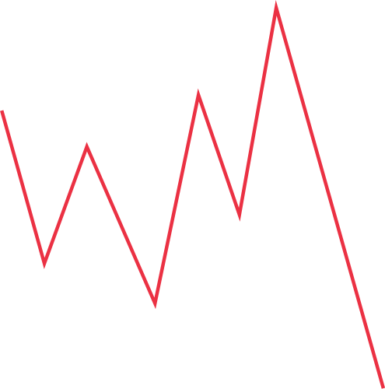


DRAWBACK AND SHOWSTOPPERS
DRAWBACKS:
SHOWSTOPPERS:
Costly setup
Internet needed
Battery limits
Repairs needed
App learning
No network
Power failure
Sensor damage

Slide 10
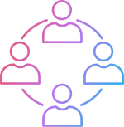
AgroVibe
The App Developer
Name: Champia MN
contact Number: +91 9345234145
Email ID: mnchampia10a@gmail.com
The Sensor Creator
Name: Vanitha S
contact Number: +91 9442847910
Email ID: vanithasaravana2005@gmail.com

Slide 11
Thank you

